Slide 1
Automate a Water Tank Controller by Using Tinkercard
Group 2
Member 1 : Liangxiao Li
Member 2 : Hui Wang
Member 3 : Md Fahim Akondo

Slide 2
Introduction :
Introduction of the project : This project aims to develop an automated water tank level control system using an Arduino Uno R3, an HC-SR04 ultrasonic sensor, a buzzer, LED indicators, and an L293D motor driver to control a DC motor.
The system continuously monitors the water level using the ultrasonic sensor. When the water level falls below a predefined threshold, the motor automatically turns on to refill the tank. Once the desired level is reached, the motor shuts off to prevent overflow. Additionally, the system provides real-time alerts through LED indicators and a buzzer, ensuring efficient water usage and reducing manual intervention.

Slide 3
Slide 2: Briefly Review Project Title and System Architecture
Title: Automated Water Tank Controller
Purpose: To design and simulate a system that automatically monitors and controls the water level in a tank using an Arduino and ultrasonic sensor.
System Architecture:
Input: Ultrasonic sensor (water level measurement)
Processing: Arduino Uno (microcontroller)
Output: LEDs (water level indication, alerts (Buzzer))
Power: 9V Battery
Briefly explain the goal: This project simulates a system that prevents water overflow and ensures a minimum water level in a tank by using an ultrasonic sensor to monitor the water level and LEDs to indicate the status and also notify by the alarm when the water level is too low.

Slide 4
Slide 3: Project Tech Stack
Hardware:
Arduino Uno microcontroller
Breadboard
Ultrasonic sensor (HC-SR04 or similar)
LEDs (different colors for various levels)
Resistors (for LEDs)
9V Battery
Connecting wires
Software:
Arduino IDE (for programming the microcontroller)
Tinkercad (for circuit design and simulation)
Programming Language: C/C++ (Arduino language)

Slide 5
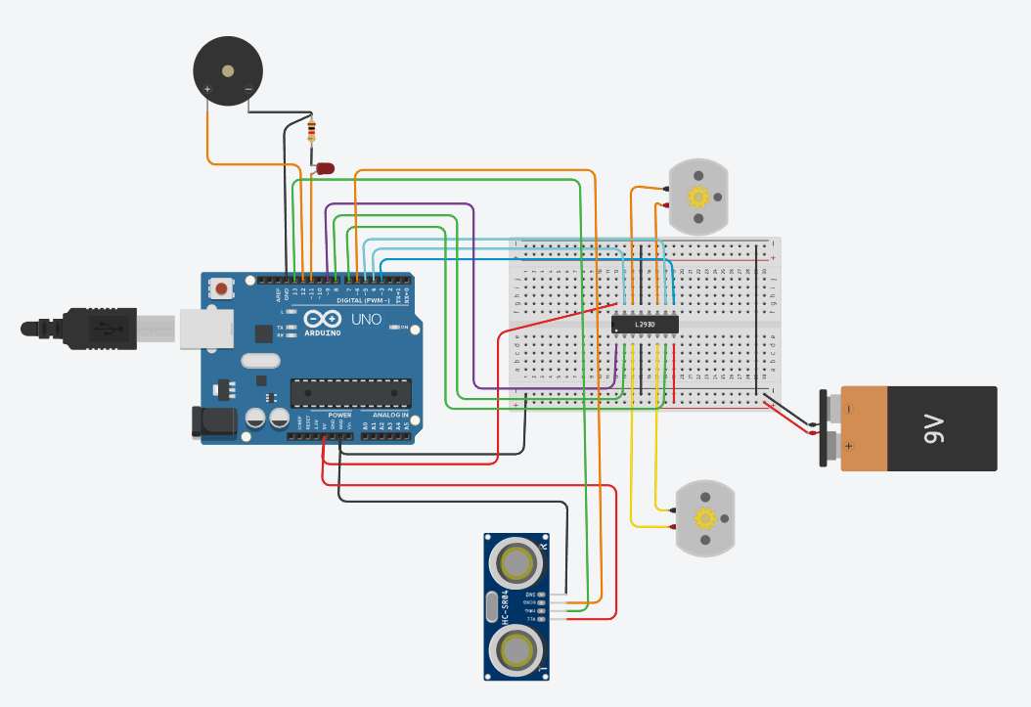
Review all Network Circuits and Class Diagrams
Circuit Diagram (Show the Tinkercad diagram):
Connections between the Arduino, ultrasonic sensor, and LEDs.
Explain the role of each component.
Focus on the sensor placement and LED logic.
Key Circuit Sections:
Ultrasonic Sensor Circuit: Explain how the sensor is positioned to measure water level.
LED Circuit: Explain the logic for different LED states based on water level
Power Circuit: 9V Battery → L293D Motor Driver:
The positive terminal of the 9V battery is connected to the Vcc2 (Pin 8) of the L293D, which is specifically used to power the motors.

Slide 6
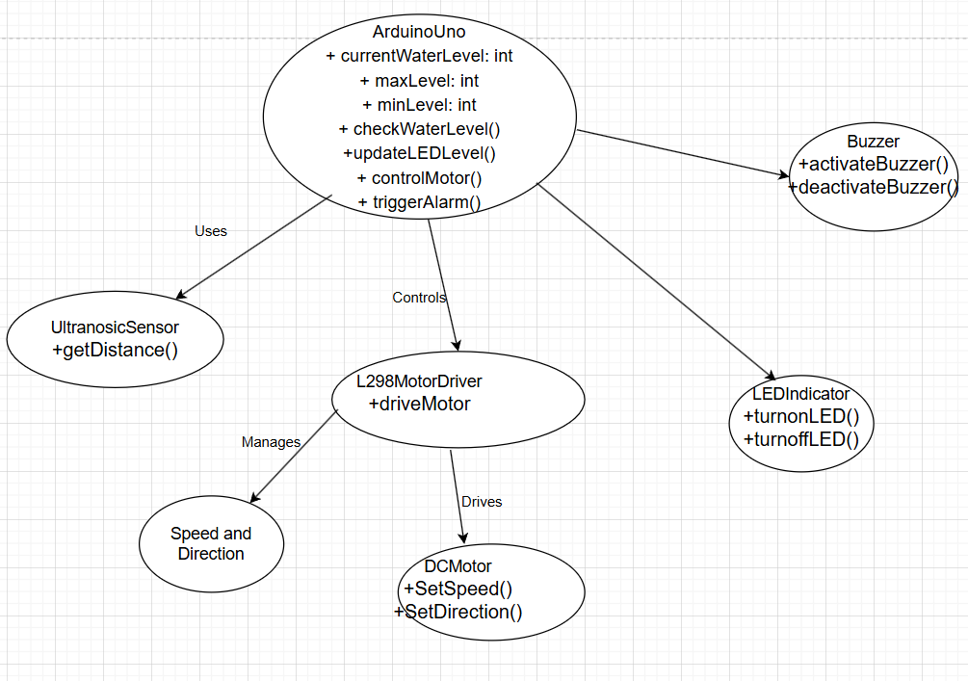

Slide 7
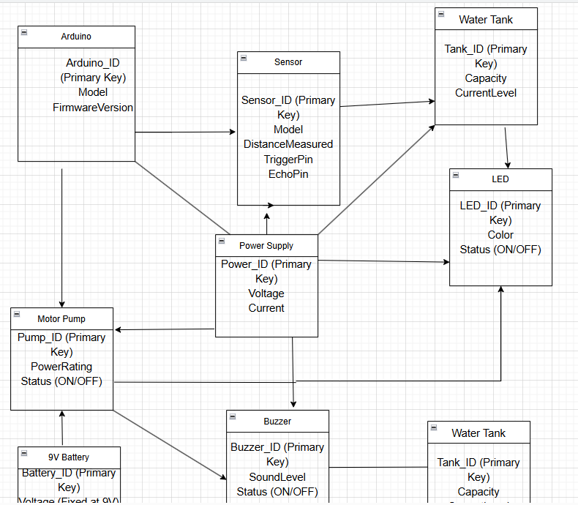

Slide 8
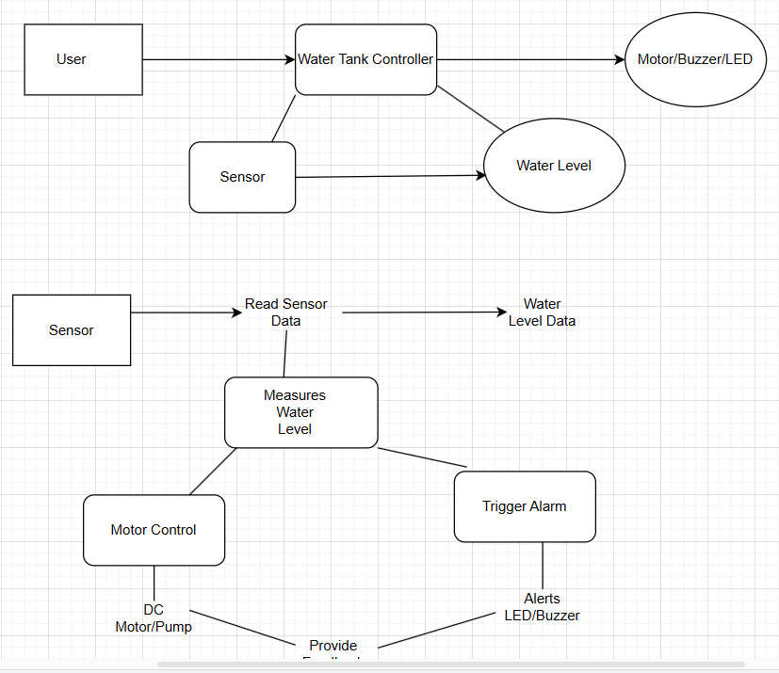

Slide 9
Results/Outputs, Drawbacks Etc.
Results/Outputs:
The system successfully detects the level within the define thresholds and activates the faucet accordingly.
The motor successfully controls the faucet based on the distance measured.
Drawbacks/Limitations:
Temperature, humidity, and air pressure fluctuations can significantly affect the ultrasonic sensor accuracy. This is a major limitation, especially for outdoor or uncontrolled environments. The HC-SR04 sensor, commonly used in these projects, has a limited range and accuracy.
Future Improvements:
Implement a machine learning model to predict water usage patterns and control the motor pump more efficiently.
By adding a second ultrasonic sensor to cross-check water levels, reducing errors caused by waves or sensor faults.

Slide 10
Reference :
Reference 1 : https://www.tinkercad.com/things/iTOG8O2j02t-projectlotteam2topic2/editel?returnTo=https%3A%2F%2Fwww.tinkercad.com%2Fdashboard&sharecode=zhP3GzLRZBtVtc6YecNKomZqgdSNmTYpKh81e_HtiVE
Reference 2 :
https://www.researchgate.net/profile/Jenny-Galay-Limos/publication/382266760_Automated_flood_water_level_sensor_and_alarm_system_using_Arduino_Uno/links/66a3536575fcd863e5dafec2/Automated-flood-water-level-sensor-and-alarm-system-using-Arduino-Uno.pdf

